Slide 1
Evaluating Cable News Bias with NLU
CDT Seth Benson
Advisor: MAJ Cruickshank

Slide 2
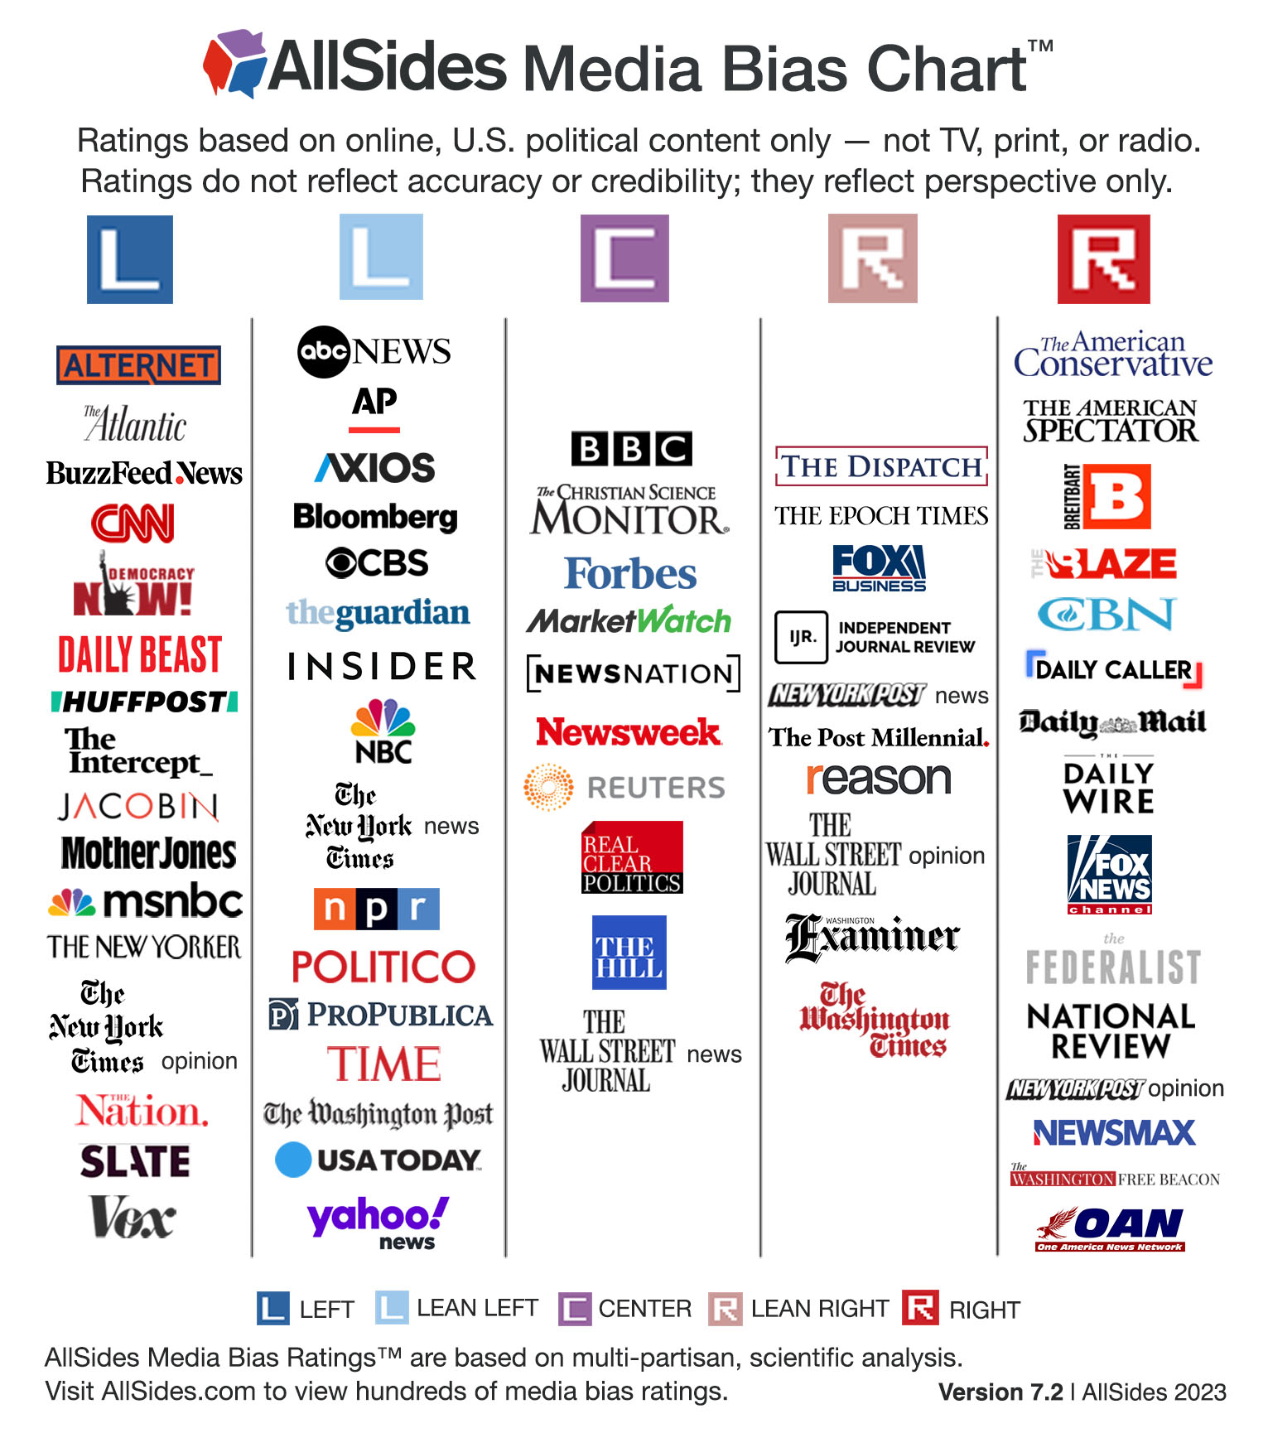
How do you determine cable news bias?
Common perception
Subjective measurements
Limited existing research

Slide 3
Goal: Dynamic Bias Description
Remove subjective assessment
Characterize media in two dimensions
What they talk about
How they talk about those things
Compare across programs to determine bias

Slide 4
Goal: Dynamic Bias Description
Data Cleaning
Store Transcript Metadata
Break Into Individual Statements
Transcript Analysis
Named Entity Recognition
VADER Sentiment Analysis
Program Comparison
TF-IDF Topic Keyword Similarity Network (T)
Sentiment Similarity Network (S)
Program Clustering
Topic-Sentiment Similarity Network
P = T ⊙ S
Program Similarity Clustering

Slide 5
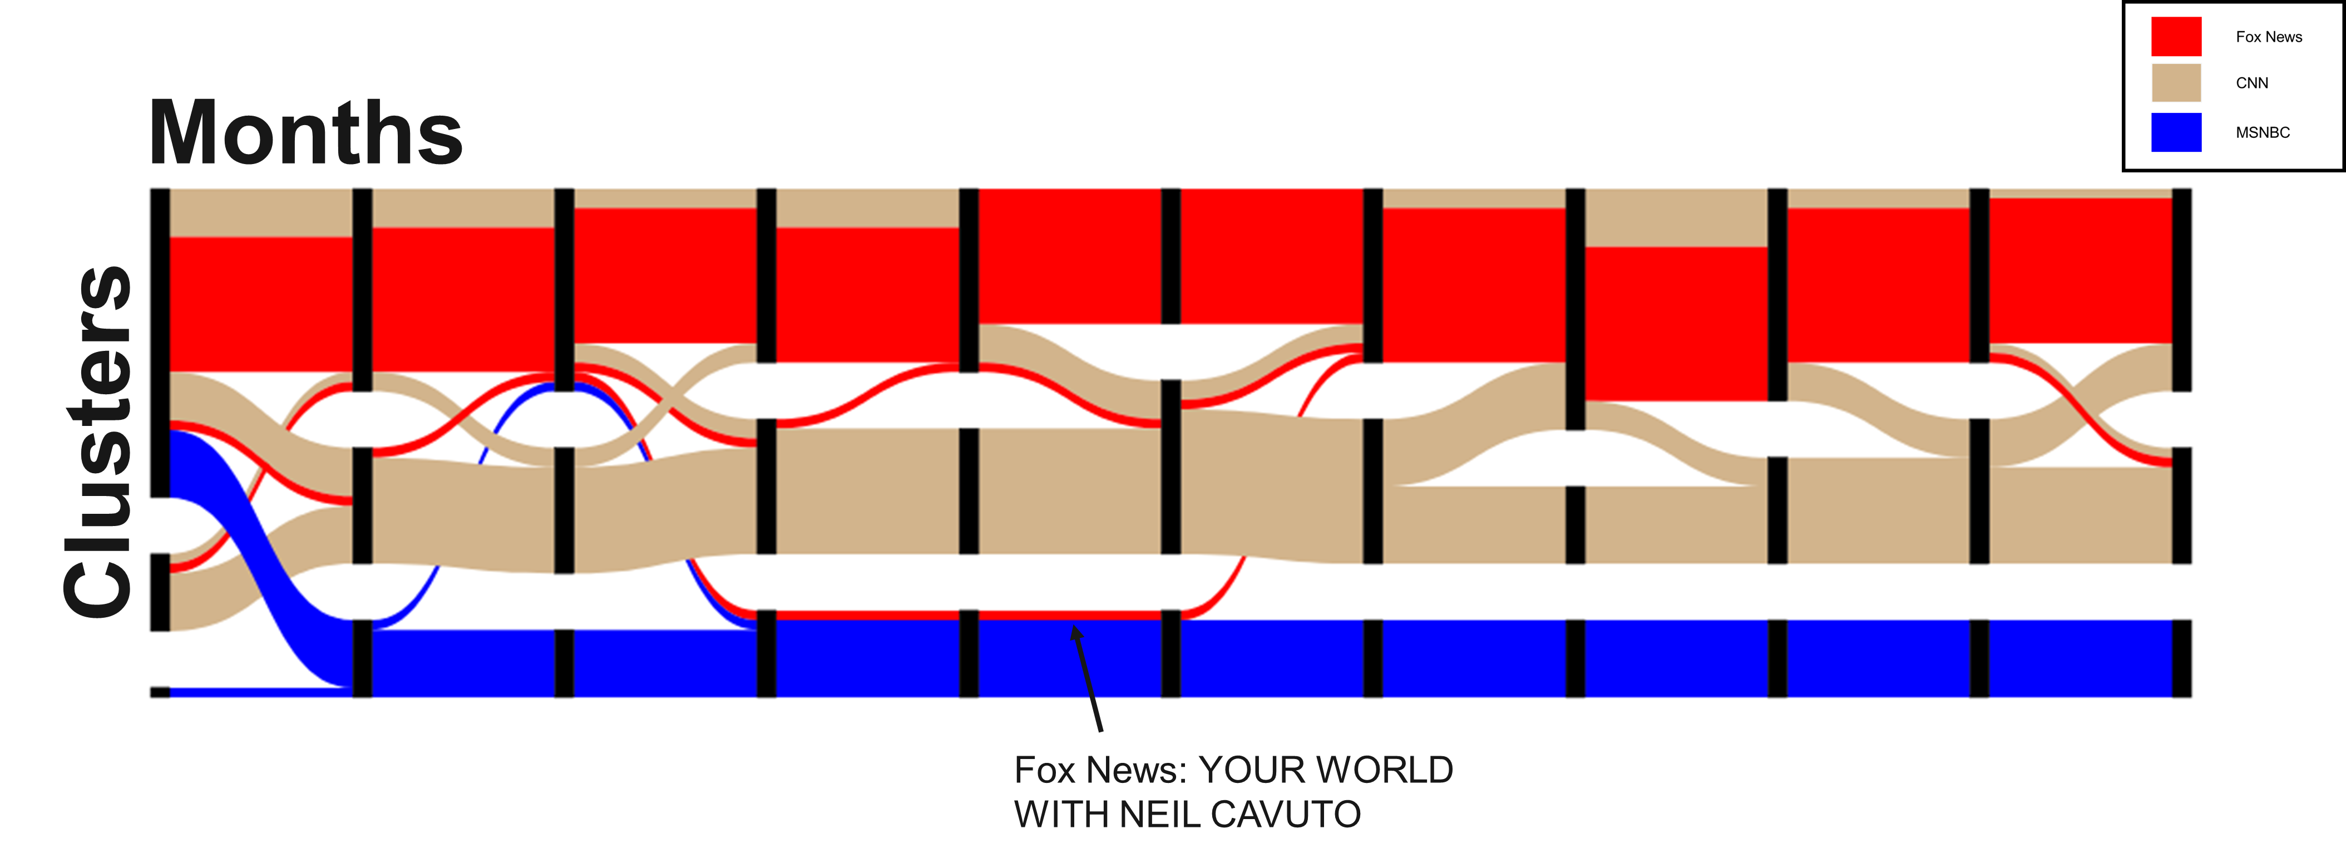
Full 2020 Results - Sankey

Slide 6
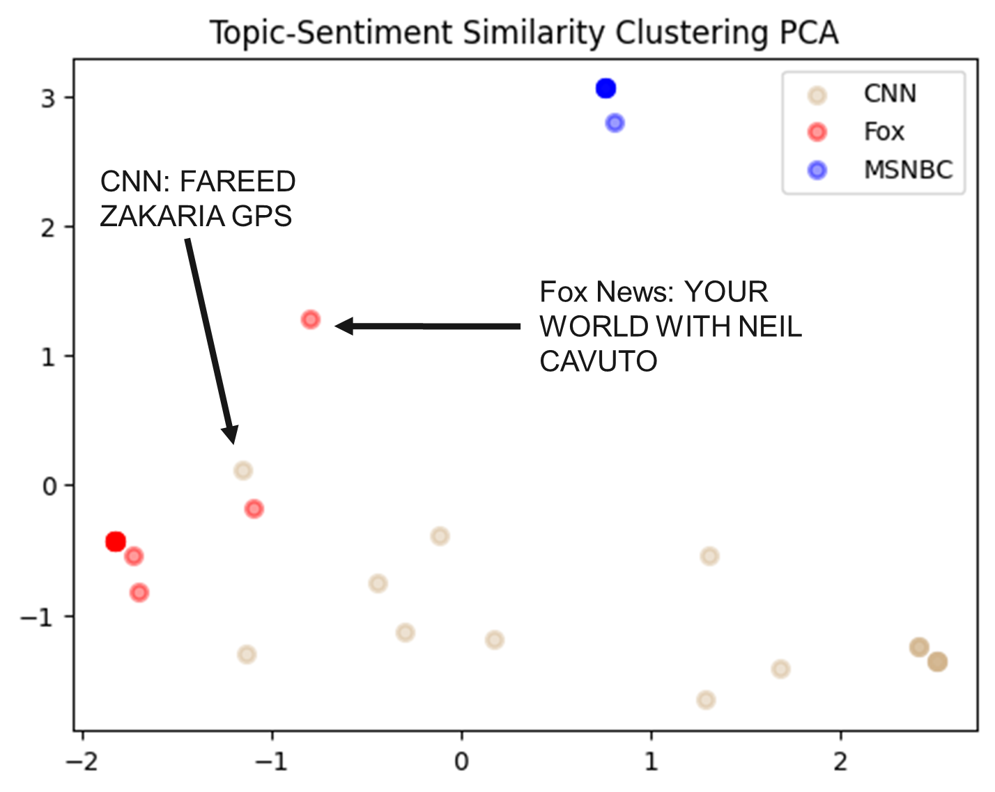
Full 2020 Results - PCA of Clusters

Slide 7
Conclusions
Clustered nature of cable news
Consistent lean of programs
Implications for military information advantage

